Slide 1


<Name>
<Date>

Slide 2

Outline
Executive Summary
Introduction
Methodology
Results
Conclusion
Appendix

Slide 3
Executive Summary
Summary of methodologies
Data Collection.
Data Wrangling.
Exploratory Data Analysis with SQL and Data Visualization.
Interactive Visual Analytics with Folium
Machine Learning Prediction
Summary of all results
Exploratory Data Analysis result
Interactive analytics in screenshots
Predictive Analytics result

Slide 4
Introduction
Project background and context
SpaceX advertises Falcon 9 rocket launches on its website at a cost of 62 million dollars, significantly less than other providers who charge upwards of 165 million dollars per launch. The substantial cost savings are primarily due to SpaceX's ability to reuse the first stage of the rocket. Consequently, determining whether the first stage will land successfully can help estimate the cost of a launch. This information is valuable for alternative companies that wish to compete with SpaceX for rocket launch contracts. The goal of this project is to create a machine learning pipeline to predict the successful landing of the first stage
Problems you want to find answers
1-Factors Influencing Successful Rocket Landings:
What factors determine if the rocket will land successfully?
How do variables such as payload mass, launch site, number of flights, and orbits affect the success of the first stage landing?
Does the rate of successful landings increase over the years?
What is the best algorithm for binary classification in this context?
How do the interactions among various features influence the success rate of a landing?
2-Optimal Operating Conditions for Successful Landings:
What operating conditions need to be in place to ensure a successful landing program?

Slide 5

Section 1

Slide 6
Methodology
Executive Summary​
Data collection methodology:​
Data was collected using SpaceX API and web scraping from Wikipedia. ​
Perform data wrangling​
One-hot encoding was applied to categorical features​
Perform exploratory data analysis (EDA) using visualization and SQL​
Perform interactive visual analytics using Folium and Plotly Dash​
Perform predictive analysis using classification models​
How to build, tune, evaluate classification models​

Slide 7
Data Collection
The data was gathered using several methods:
1-API Requests:
Data was collected by sending GET requests to the SpaceX API.
The response content was decoded as JSON using the .json() function call and converted into a pandas DataFrame using .json_normalize().
2-Data Cleaning:
The data was cleaned by checking for missing values and filling them where necessary.
3-Web Scraping:
Additional data was gathered from Wikipedia for Falcon 9 launch records using BeautifulSoup.
The objective was to extract the launch records from an HTML table, parse the table, and convert it into a pandas DataFrame for further analysis.

Slide 8
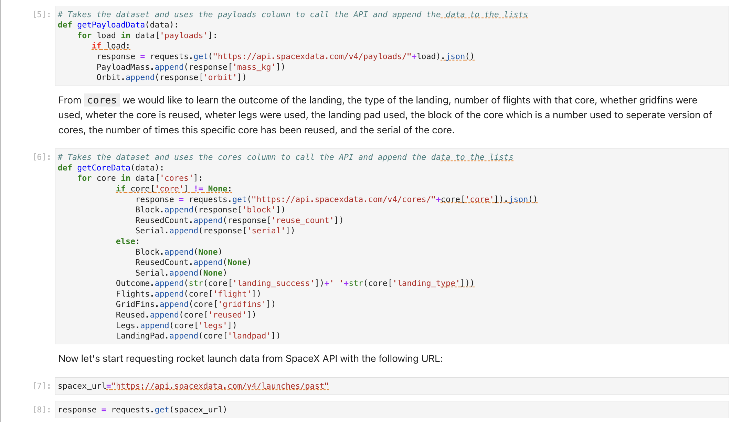
Data Collection – SpaceX API
We used the get request to the SpaceX API to collect data, clean the requested data and did some basic data wrangling and formatting.
The link to the notebook is:https://github.com/nshaghluf/data-collection-/blob/main/jupyter-labs-spacex-data-collection-api.ipynb

Slide 9
Data Collection - Scraping
We applied web scrapping to webscrap Falcon 9 launch records with BeautifulSoup
We parsed the table and converted it into a pandas dataframe.
The link to the notebook is https://github.com/nshaghluf/data-collection-/blob/main/jupyter-labs-webscraping.ipynb

Slide 10

Data Wrangling
We performed exploratory data analysis.
We calculated the number of launches at each site, and the number and occurrence of each orbits
We created landing outcome label from outcome column and exported the results to csv.
The link to the notebook is https://github.com/nshaghluf/data-collection-/blob/main/labs-jupyter-spacex-Data%20wrangling.ipynb
10

Slide 11

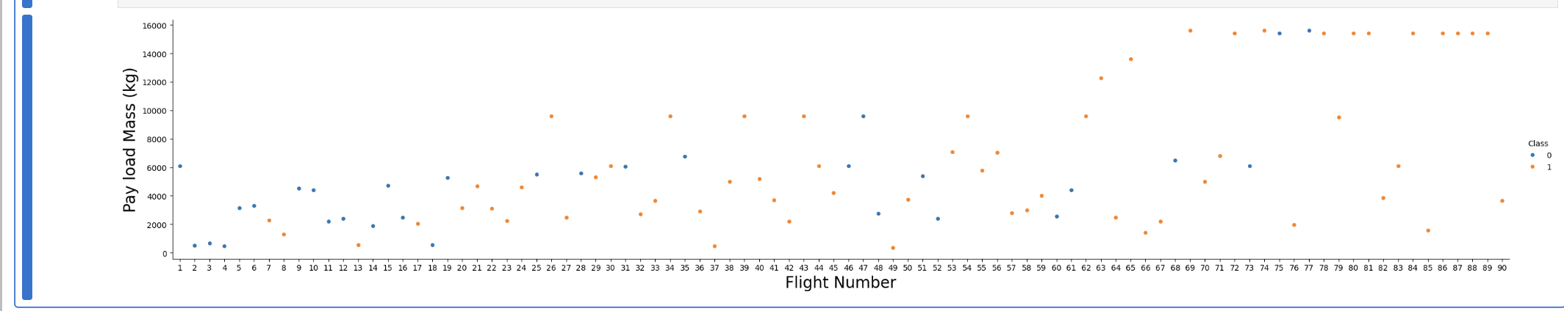
EDA with Data Visualization
We explored the data by visualizing the following relationships:
The relationship between flight number and launch site
The relationship between payload and launch site
The success rate of each orbit type
The relationship between flight number and orbit type
The yearly trend of launch success
The link to the notebook is:https://github.com/nshaghluf/data-collection-/blob/main/edadataviz.ipynb

Slide 12
EDA with SQL
We loaded the SpaceX dataset into a PostgreSQL database directly within the Jupyter Notebook.
Next, we performed Exploratory Data Analysis (EDA) using SQL to gain insights from the data. We wrote queries to uncover information such as:
The names of unique launch sites in the space mission.
The total payload mass carried by boosters launched by NASA (CRS).
The average payload mass carried by booster version F9 v1.1.
The total number of successful and failed mission outcomes.
The failed landing outcomes on drone ships, including their booster versions and launch site names.
The link for the notebooke is :https://github.com/nshaghluf/data-collection-/blob/main/jupyter-labs-eda-sql-coursera_sqllite.ipynb

Slide 13
Build an Interactive Map with Folium
We visualized all launch sites and added map objects such as markers, circles, and lines to indicate the success or failure of launches at each site on a Folium map.
We assigned the feature launch outcomes to classes: 0 for failure and 1 for success.
Using color-labeled marker clusters, we identified which launch sites have relatively high success rates.
We calculated the distances between each launch site and nearby features to answer questions such as:
Are launch sites near railways, highways, and coastlines?
Do launch sites maintain a certain distance from cities?
The link is :https://github.com/nshaghluf/data-collection-/blob/main/lab_jupyter_launch_site_location.ipynb

Slide 14
Build a Dashboard with Plotly Dash
We developed an interactive dashboard using Plotly Dash.
We created pie charts to display the total number of launches at specific sites.
We plotted scatter graphs to illustrate the relationship between outcome and payload mass (kg) for different booster versions.
The link for the notebook is: https://theianext-1-labs-prod-misc-tools-us-east-0.labs.cognitiveclass.ai/user/nshaghluf/#

Slide 15
Predictive Analysis (Classification)
We loaded the data using NumPy and pandas, transformed it, and split it into training and testing sets.
We built various machine learning models and tuned their hyperparameters using GridSearchCV.
Using accuracy as our metric, we improved the models through feature engineering and algorithm tuning.
We identified the best-performing classification model.
The link for the notebook is:https://github.com/nshaghluf/data-collection-/blob/main/SpaceX_Machine%20Learning%20Prediction_Part_5.ipynb

Slide 16
Results
Exploratory data analysis results
Interactive analytics demo in screenshots
Predictive analysis results

Slide 17

Section 2

Slide 18
Flight Number vs. Launch Site
The plot revealed that higher numbers of flights at a launch site correlate with a greater success rate at that site.

Slide 19
Payload vs. Launch Site
The plot revealed that the greater the payload mass at launch site CCAFS SLC 40, the higher the success rate for the rocket.

Slide 20

Success Rate vs. Orbit Type
From the plot, we can see that ES-L1, GEO, HEO, SSO, VLEO had the most success rate.

Slide 21
Flight Number vs. Orbit Type
The plot below illustrates the relationship between flight number and orbit type. It shows that in the LEO orbit, success is correlated with the number of flights, whereas in the GTO orbit, there is no observed relationship between flight number and success.

Slide 22
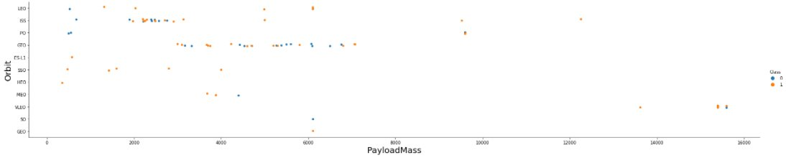
Payload vs. Orbit Type
We observe that with heavy payloads, successful landings are more frequent for PO, LEO, and ISS orbits.

Slide 23
Launch Success Yearly Trend
The plot shows that the success rate has steadily increased from 2013 to 2020.

Slide 24
All Launch Site Names
We used the keyword DISTINCT to display only the unique launch sites from the SpaceX data.
Launch_Site 0 CCAFS LC-40 1 VAFB SLC-4E 2 KSC LC-39A 3 CCAFS SLC-40

Slide 25
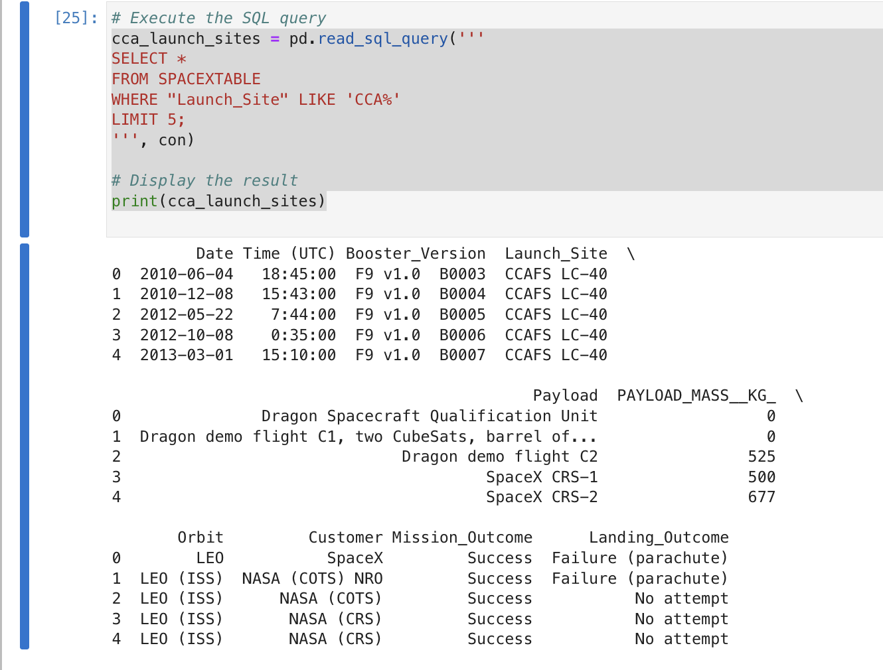
Launch Site Names Begin with 'CCA'
We used the query below to display 5 records where launch sites begin with `CCA`

Slide 26
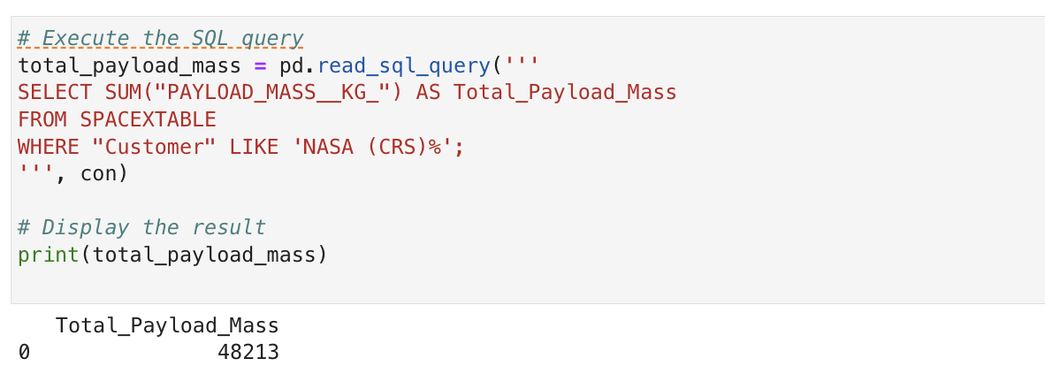
Total Payload Mass
We calculated the total payload carried by NASA boosters to be 45,596 kg using the following query.

Slide 27
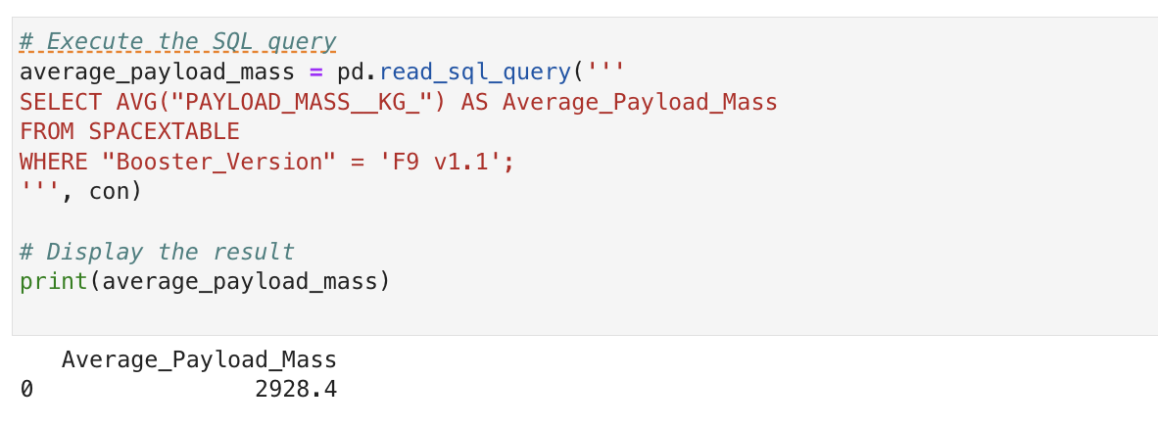
Average Payload Mass by F9 v1.1
We calculated the average payload mass carried by booster version F9 v1.1 as 2928.4

Slide 28
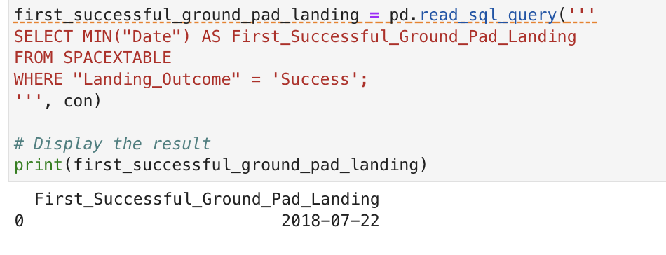
First Successful Ground Landing Date
We observed that the dates of the first successful landing outcome on ground pad was 22nd July 2018

Slide 29
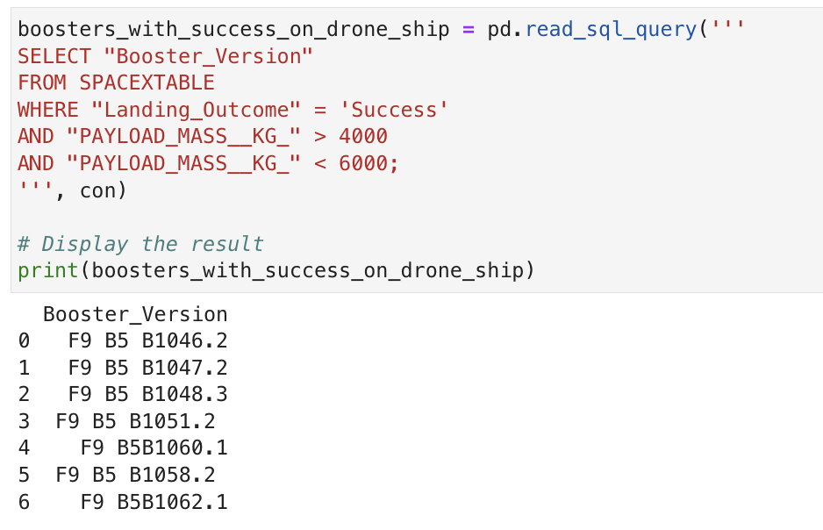
Successful Drone Ship Landing with Payload between 4000 and 6000
The names of boosters which have successfully landed on drone ship and had payload mass greater than 4000 but less than 6000 are 0 F9 B5 B1046.2 1 F9 B5 B1047.2 2 F9 B5 B1048.3 3 F9 B5 B1051.2 4 F9 B5B1060.1 5 F9 B5 B1058.2 6 F9 B5B1062.1

Slide 30
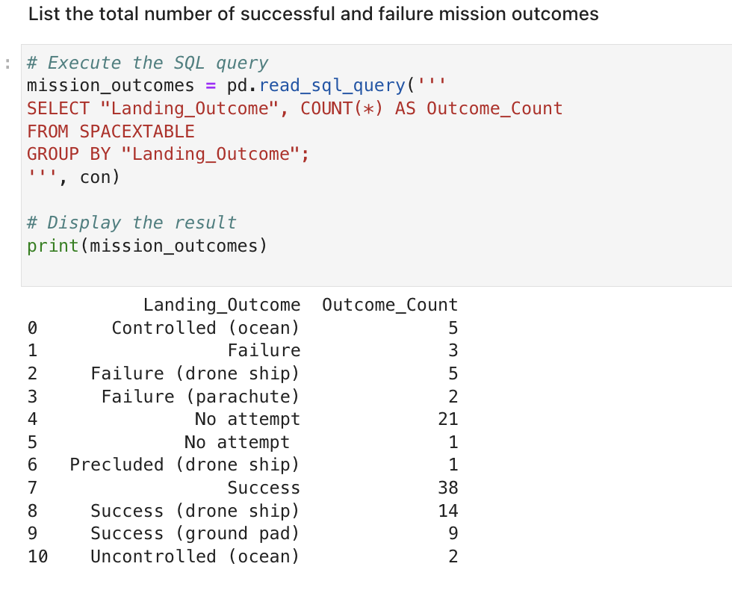
Total Number of Successful and Failure Mission Outcomes
The total number of successful and failure mission outcomes are listed below

Slide 31
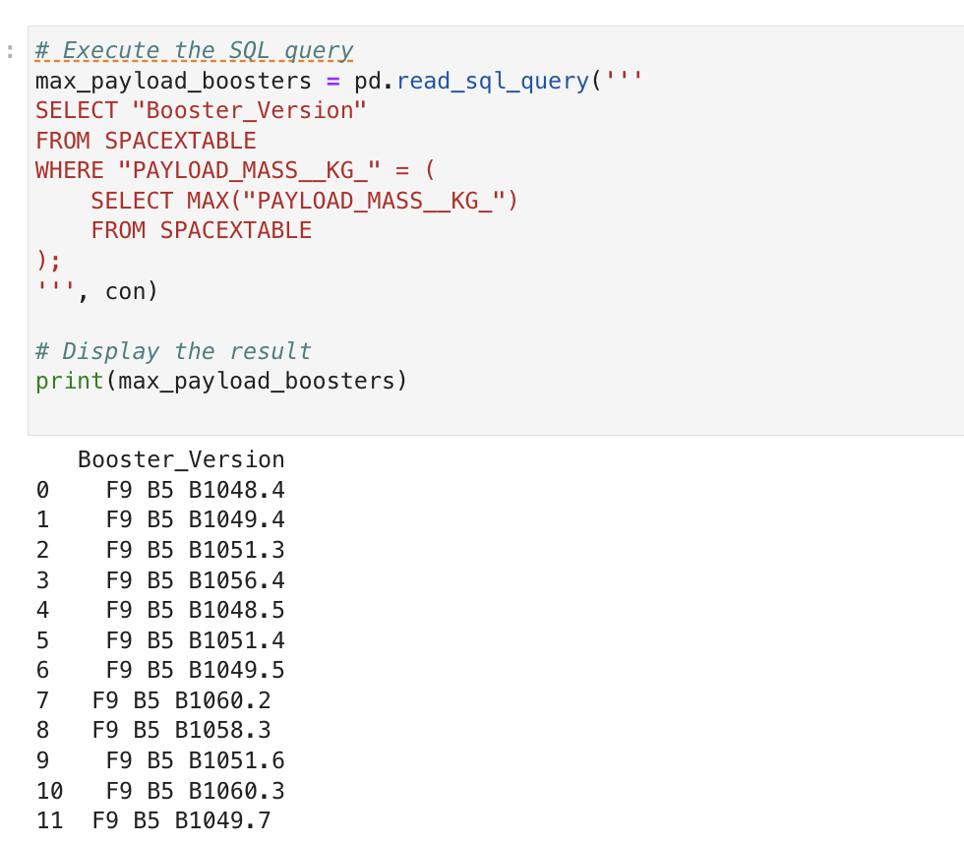
Boosters Carried Maximum Payload
The names of the booster which have carried the maximum payload mass

Slide 32
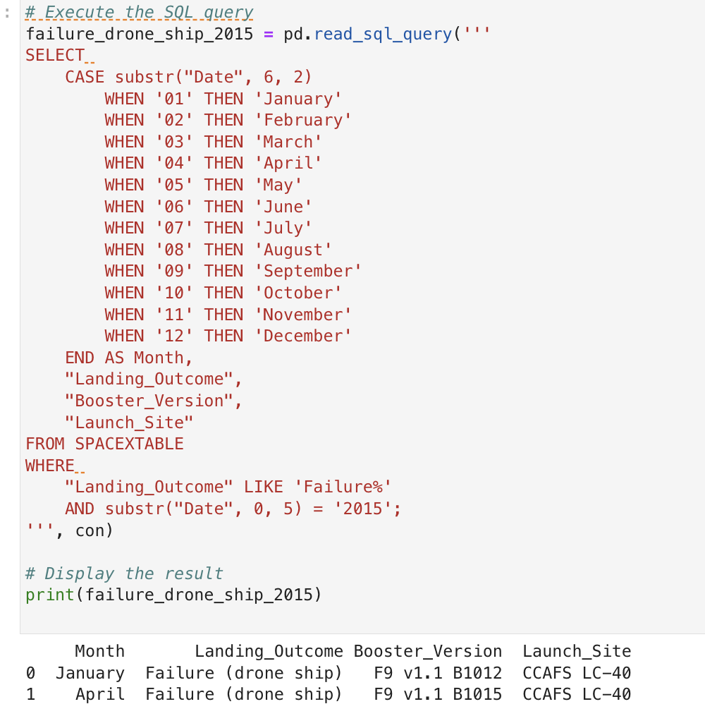
2015 Launch Records
the failed landing_outcomes in drone ship, their booster versions, and launch site names for in year 2015 are:
0 January Failure (drone ship) F9 v1.1 B1012 CCAFS LC-40 1 April Failure (drone ship) F9 v1.1 B1015 CCAFS LC-40

Slide 33
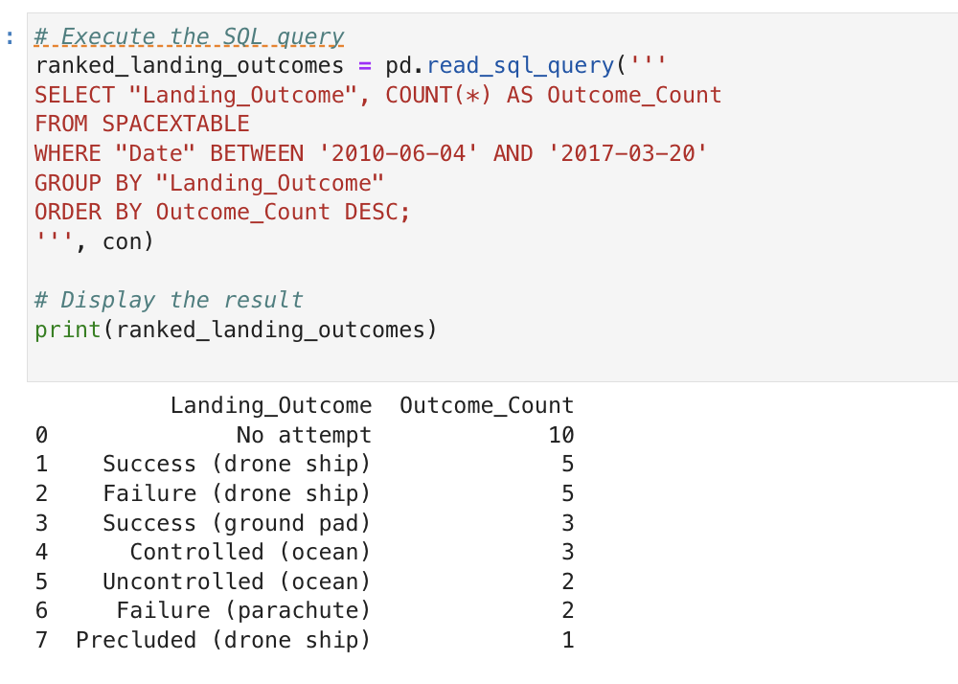
Rank Landing Outcomes Between 2010-06-04 and 2017-03-20
The count of landing outcomes (such as Failure (drone ship) or Success (ground pad)) between the date 2010-06-04 and 2017-03-20, in descending order

Slide 34

Section 3

Slide 35
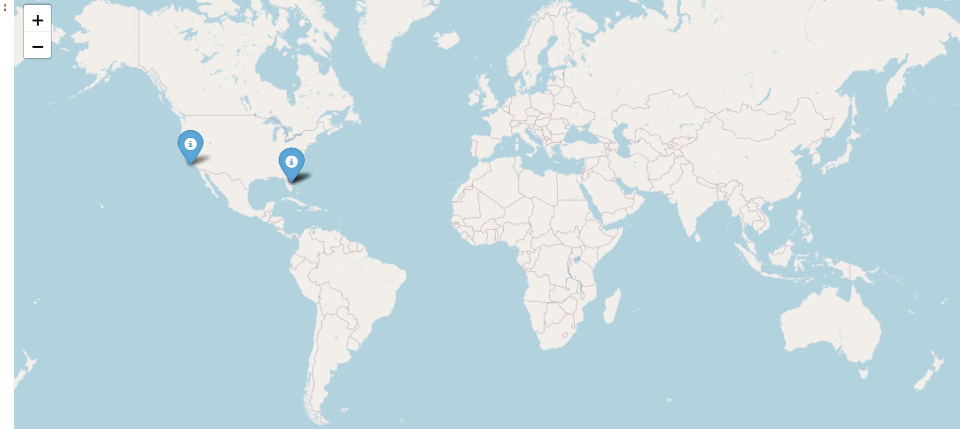
All launch sites global map markers

Slide 36
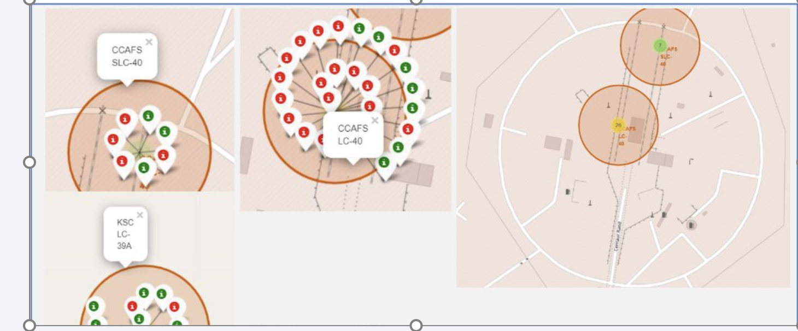
Markers showing launch sites with color labels

Slide 37
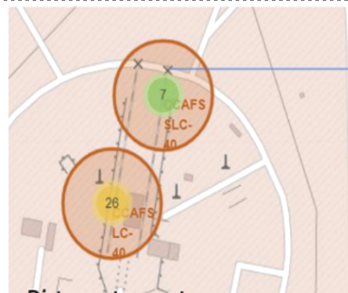
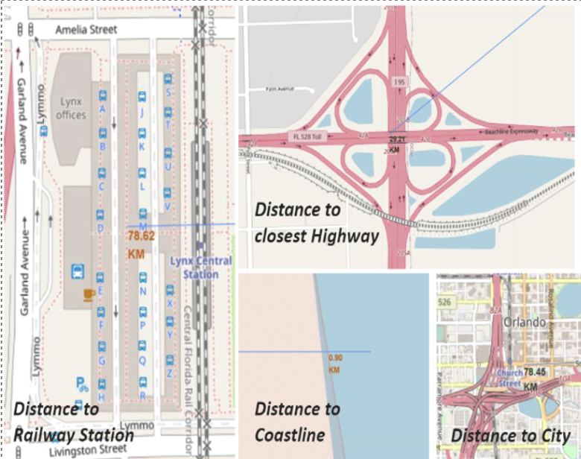
Launch Site distance to landmarks

Slide 38

Section 4

Slide 39

Pie chart showing the success percentage achieved by each launch site

Slide 40
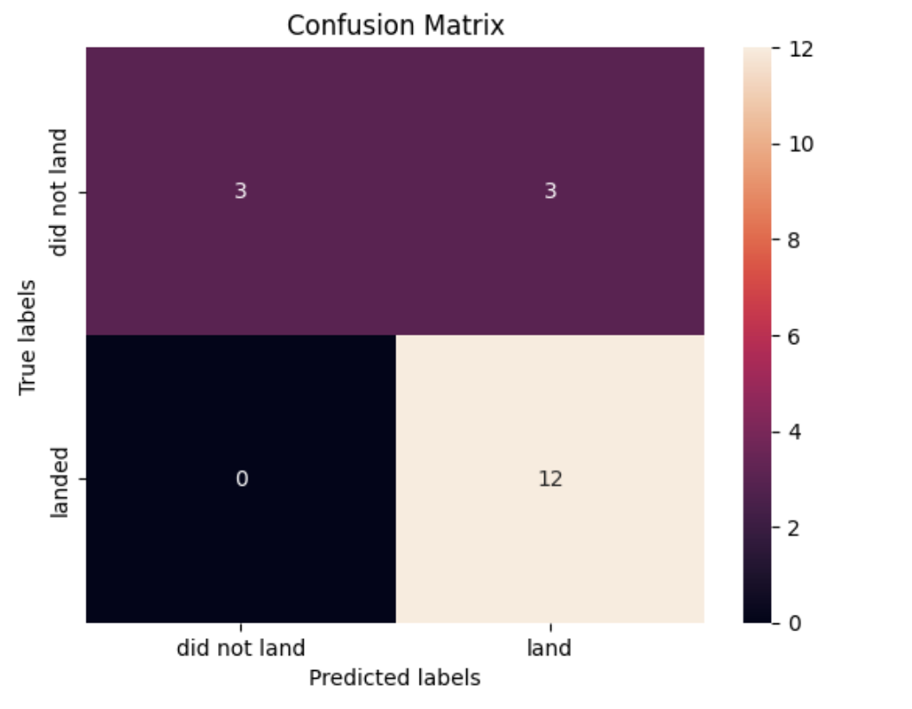
Confusion Matrix

Slide 41

Section 5

Slide 42
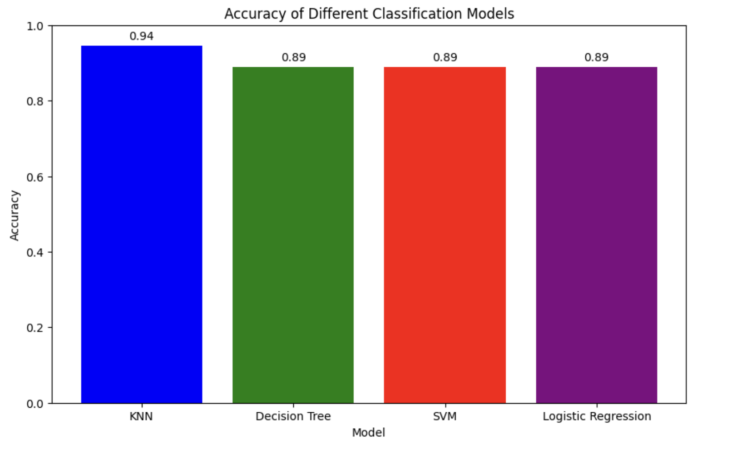
Classification Accuracy
We Visualize the built model accuracy for all built classification models, in a bar chart as shown:
The KNN is the model with the highest classification accuracy.

Slide 43
Confusion Matrix
The confusion matrix for the decision tree classifier demonstrates that the classifier can differentiate between the different classes. However, the primary issue is the occurrence of false positives, where unsuccessful landings are incorrectly marked as successful by the classifier.

Slide 44
Conclusions
We can conclude the following:
The greater the number of flights at a launch site, the higher the success rate.
The launch success rate began to increase from 2013 and continued to improve until 2020.
The orbits ES-L1, GEO, HEO, SSO, and VLEO had the highest success rates.
KSC LC-39A had the most successful launches among all the sites.
The decision tree classifier proved to be the best machine learning algorithm for this task.

Slide 45


